Slide 1
JavaScript
Events
PHP web development 2019/2020
Milena Tomova
Vratsa Software
https://vratsasoftware.com/

Slide 2
Table of Contents
JavaScript Event Model
Registering events
HTML Attributes,
DOM Properties
DOM methods
Event object

Slide 3
JavaScript Event Model

Slide 4
JavaScript Event Model
JS Event Model
DOM event model - allows user-browser interaction
Consists of event/events and event listener(s), attached to a DOM object

Slide 5
Event Types

Slide 6
Event types
event types
Event type groups
Mouse events
Touch events
Form events
Keyboard events
DOM events
Custom events
Full event types list

Slide 7
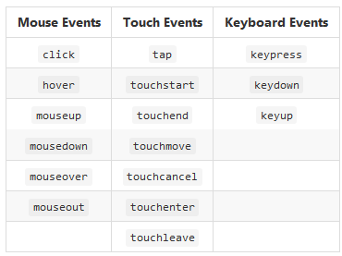
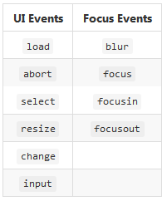
Event Types

Slide 8
registering an
Event

Slide 9
Event Handlers
Event Handler
Registering an event through a callback function for a specific event type and for a specific DOM element/s
We can register event as -
a HTML attribute
using a DOM property
using DOM event handler

Slide 10
HTML Attribute
in HTML
<button onclick="onButtonClick()">Click Me</button>
in JS
function onButtonClick() { console.log("You clicked the Button"); }

Slide 11
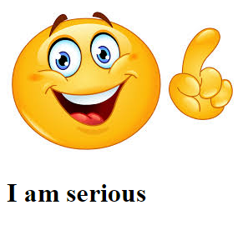
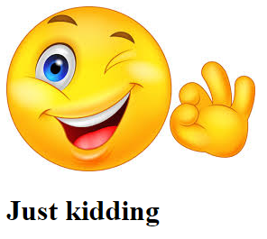
As an HTML Attribute - TASK
Напишете JS, с който при преминаване с мишката над картинката - от усмихната става сериозна и текста под картинката се променя от
I am serious на Just Kidding!

Slide 12
Register Event Handlers using a property of a DOM element
Register Event Handlers using a property of a DOM element
html
<button id="click-button">Click me</button>
JavaScript
var button = document.getElementById("click-button"); button.onclick = function onButtonClick() { console.log("You clicked the button"); }
a JS is prepared /the button with id=click-button/
it waits for an event - to be clicked /button.onclick/
and will do what is set in the script /console.log("You clicked the button")/

Slide 13
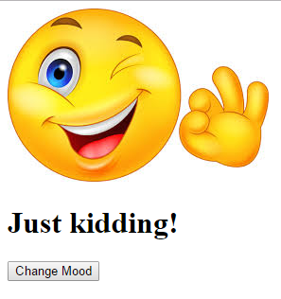
Register ... a property of a DOM element - task
Напишете JS код, който сменява настроението на Smiley след натискане на бутон.

Slide 14
Using DOM Event Listeners
domElement.addEventListener(eventType, eventHandler, isCaptureEvent);
var button = document.getElementById("click-button"); button.addEventListener("click", whenClickedFunc, false);
function whenClickedFunc() { console.log("You clicked me"); }
var button = document.getElementById("click-button"); button.addEventListener("click", function () { console.log("You clicked me"); }, false);

Slide 15
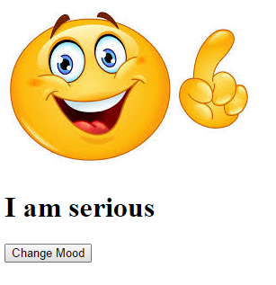
Using DOM Event Listeners - TASK
Напишете JS код, който сменява настроението на Smiley след натискане на бутон.

Slide 16
Event Object

Slide 17
Event Object
Event Object
When handling an event we/event handlers/ have access to the event object.
It contains info for -
the event type
event target
the key /if keyboard event/ that has triggered the event
the mouse button /if mouse event/ that has been clicked and triggered the event
the mouse position on the screen
For debugging purposes

Slide 18
Event Object
to access the event target
function onButtonClick(event) { console.log(event.target); console.log(event.type); console.log(event.clientX, event.clientY); }
button.addEventListener("click", onButtonClick, false);

Slide 21



Trainings @ Vratsa Software
Vratsa Software – High-Quality Education, Profession and Jobs
www.vratsasoftware.com
The Nest Coworking
www.nest.bg
Vratsa Software @ Facebook
www.fb.com/VratsaSoftware
Slack Channel
www.vso.slack.com

